Slide 1
Football Players Movement Analysis in Panning Videos
Karol Działowski and Paweł Forczmański
Faculty of Computer Science and Information Technology, West Pomeranian
University of Technology, Szczecin, Żołnierska Street 49, 71-210 Szczecin, Poland
karoldzialowski@gmail.com
pforczmanski@wi.zut.edu.pl

Slide 2
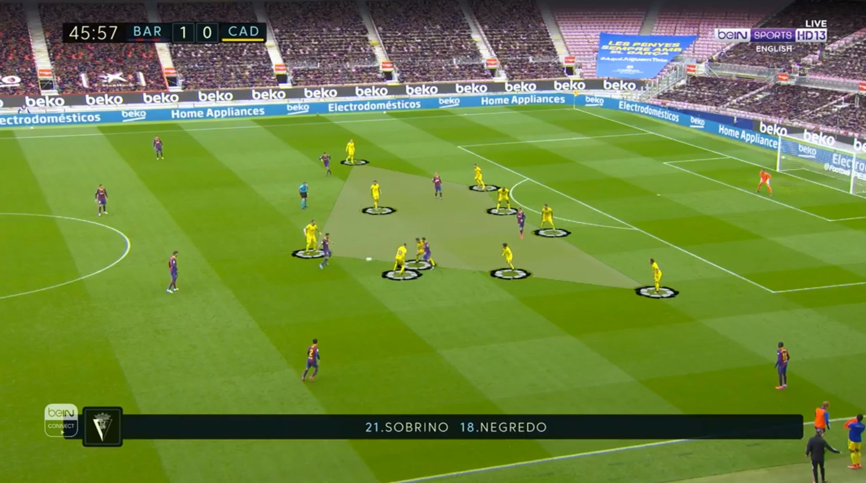
Background
The popularity of football
How the data can be used in football
What data should be collected
Background
Objective
Method
Results
Conclusions
Notes:
1. Football is one of the most popular team sports
2. Data has more important role in football
3. Data an be used for:
Augmented reality
Tactical analysis
Players and teams evaluation
Verification of referee decision
4. We need players position on the pitch surface.

Slide 3
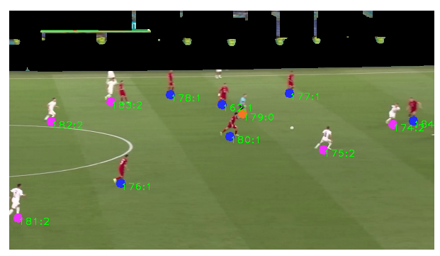
Background
Background
Objective
Method
Results
Conclusions

Slide 4
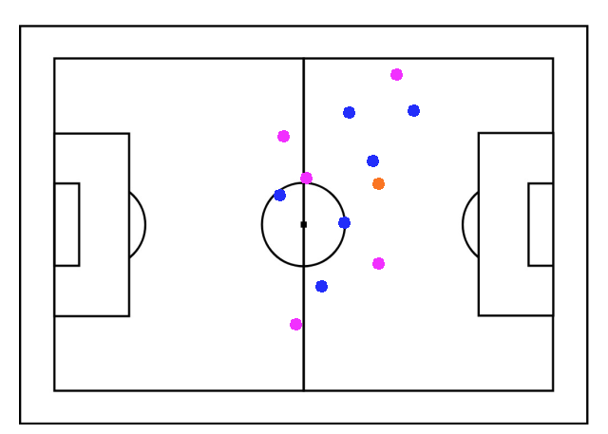
Background
Background
Objective
Method
Results
Conclusions

Slide 5
Related works
Field Registration:
Manual calibration [Ghanem2012]
Automatic calibration [Sharma2018, Chen2019]
Player Detection:
HOG detector [Santosh2019]
CNN multibox detector [Ramanathan2016]
Complete systems:
Multi-camera tracking [Baysal2015]
Background
Objective
Method
Results
Conclusions
Notes:
Topic is popular among researchers
We have found many articles about this topic

Slide 6
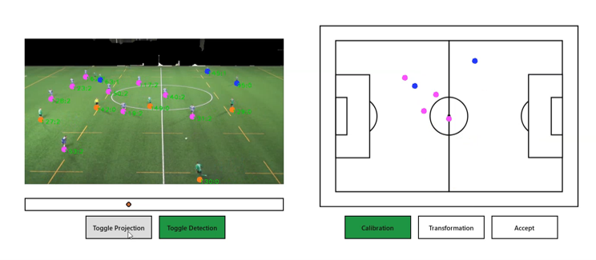
Objective
Research affordable way of collecting data
Use footage from a single camera
Limitations of input video
Background
Objective
Method
Results
Conclusions
Notes:
Collecting the football data is usually expensive
Requires complex systems (multiple camera, special equipment)
We wanted to show the possibility of collecting such data using single camera

Slide 7
Method
Background
Objective
Method
Results
Conclusions
Player detection with YOLOv3 detector
Semi automatic camera calibration
Camera angle modelling using optical flow
Homography interpolation
Player classification into teams
Notes:
The proposed method can be divided into 3 subproblems

Slide 8
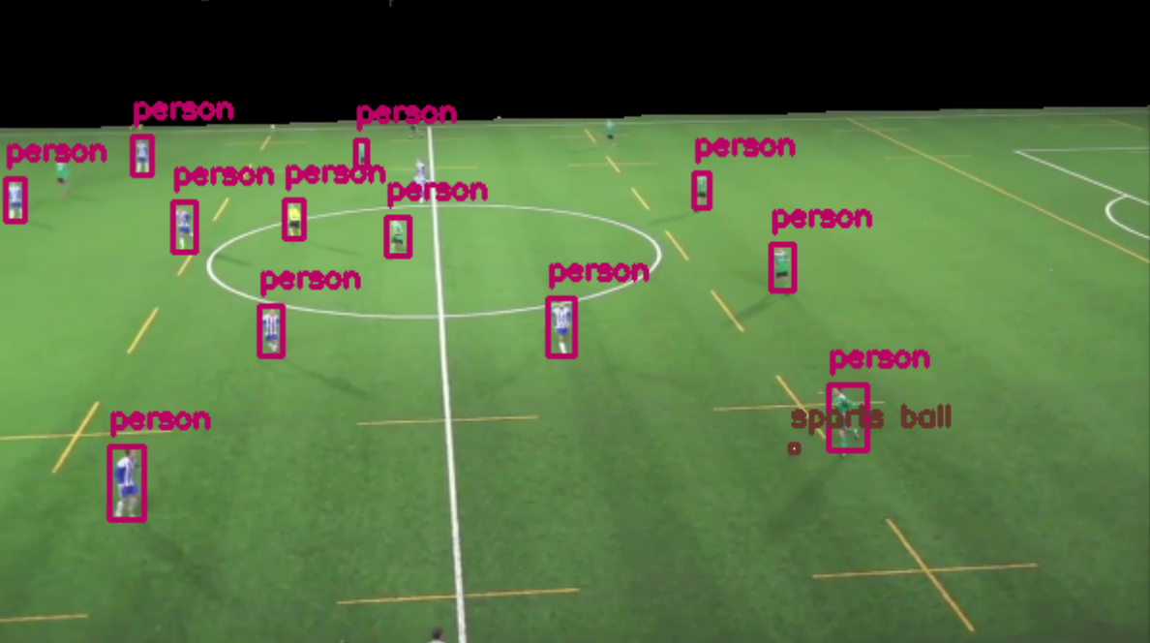
Method: Player detection
Detection performed by YOLOv3 detector
Detection limited to football pitch using color segmentation
Background
Objective
Method
Results
Conclusions
Notes:
We perform player detection using pretrained YOLOv3 detector
Detection is done only on pitch area – segmentation with color

Slide 9
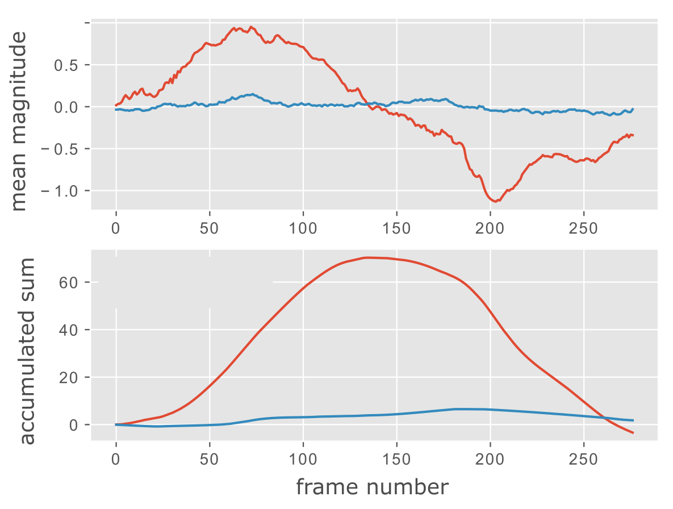
Method: Camera angle modelling
Approximation of horizontal panning with Optical Flow
Background
Objective
Method
Results
Conclusions
Notes:
Camera angle modelling is required step for finding homography for every frame of the input video

Slide 10
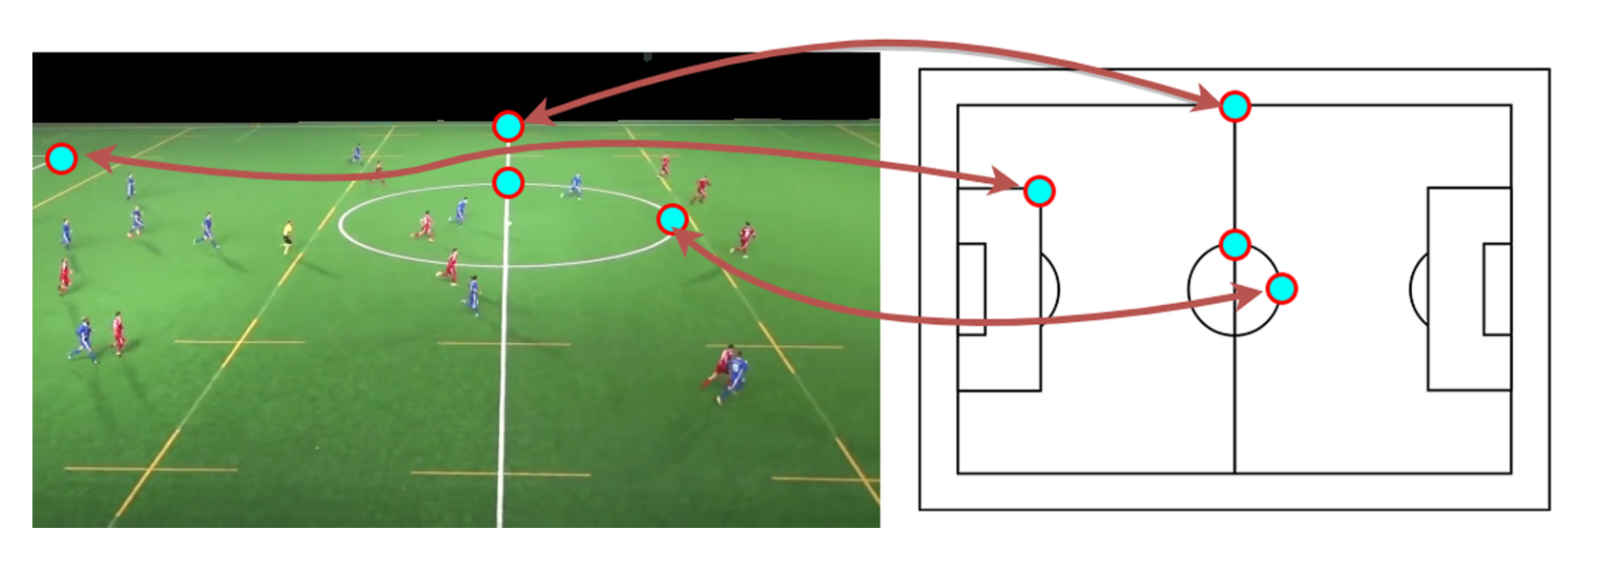
Method: Camera Calibration
Calibration of a few frames
Interpolation based on camera angle model
Background
Objective
Method
Results
Conclusions
Notes:
The only manual step in proposed method.
User has to calibrate few frames (2 or 3 frames)

Slide 11
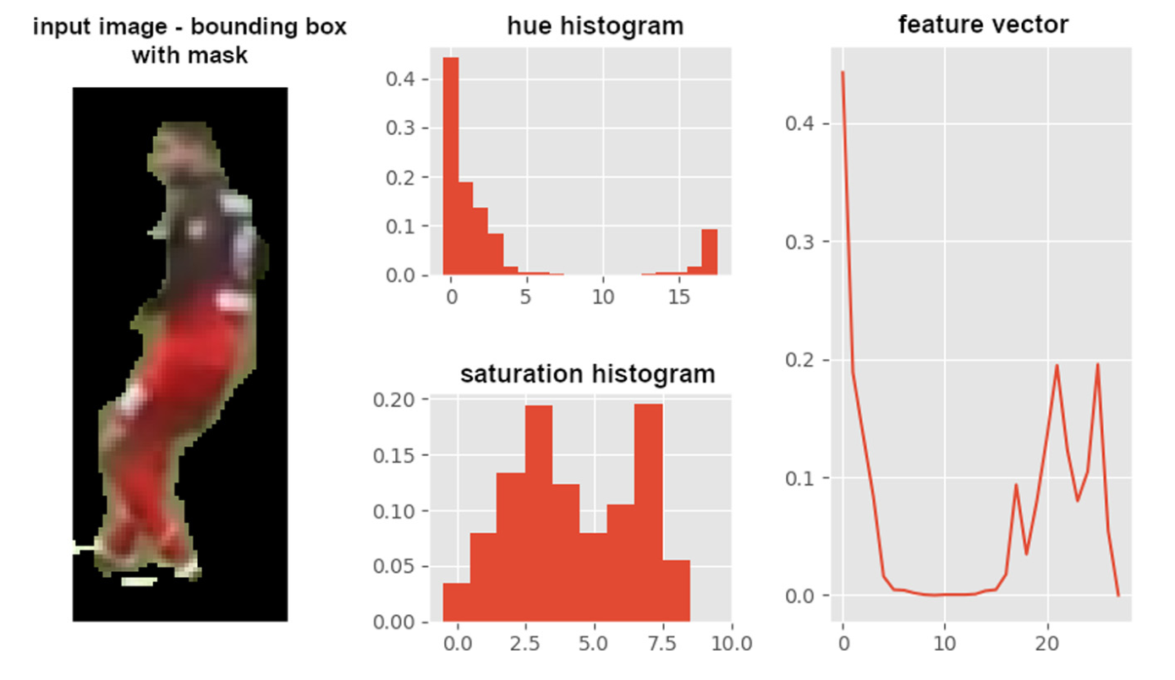
Method: Player classification
Hue and Saturation histograms
Division into upper and lower halves (t-shirt and shorts)
Classes are defined using clustering
Background
Objective
Method
Results
Conclusions
Notes:
Player classification with decision tree
Classes are found with unsupervised learning
Features are calculated from two halves. It improves accuracy.

Slide 12
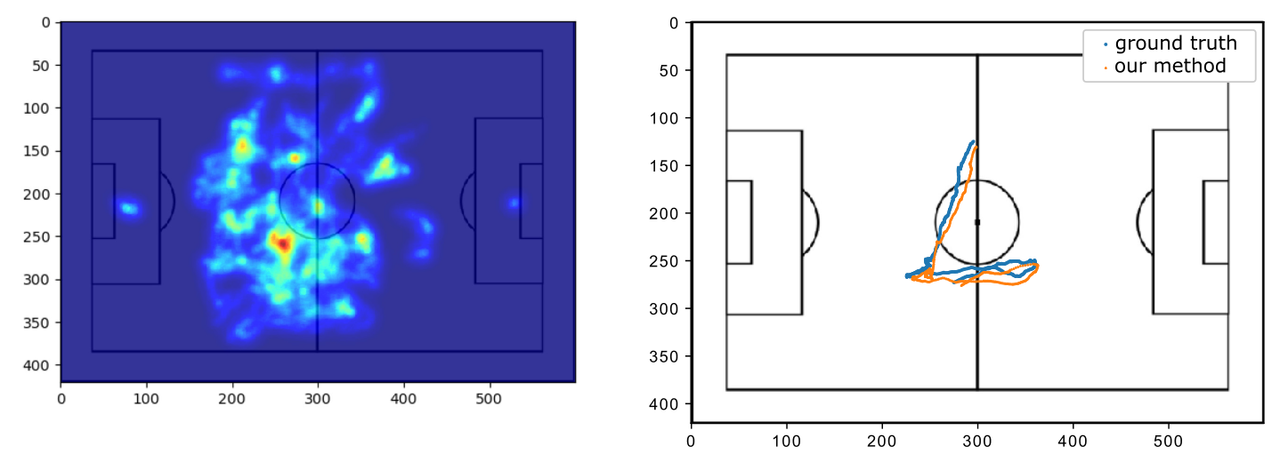
Results
Heatmaps comparison
Player trajectory comparison
Background
Objective
Method
Results
Conclusions
Notes:
Qualitative and quantitative results
Compared heatmaps and players paths
Collected ground truth data

Slide 13
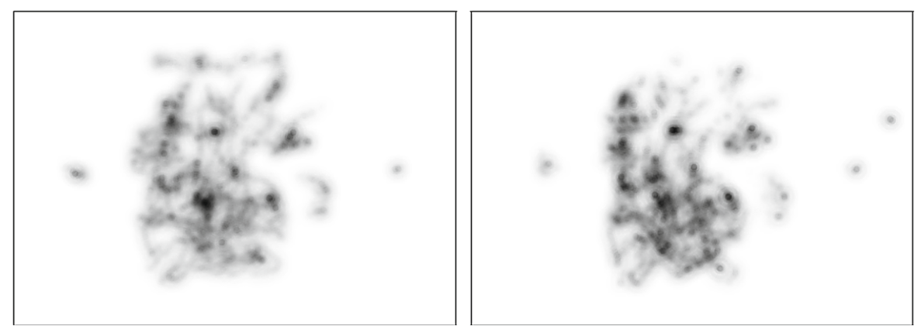
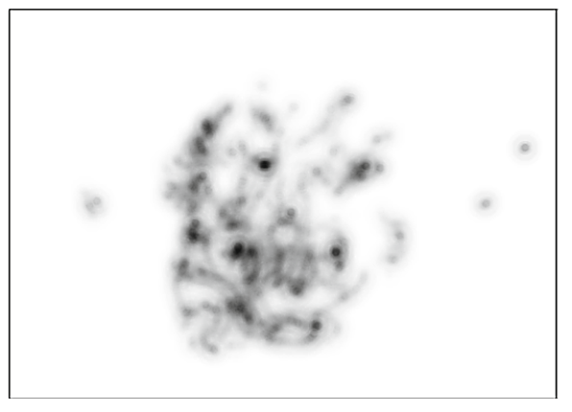
Results: Heatmaps
Compared using SSIM
Background
Objective
Method
Results
Conclusions
Ground truth
3 key-frames
2 key-frames
Notes:
Heatmaps were compared using SSIM

Slide 14
Results: Heatmaps
Background
Objective
Method
Results
Conclusions
Calibration method | Video material
 | 1 | 2 | 3
3 key-frames | 0.875 | 0.871 | 0.831
2 key-frames | 0.857 | 0.858 | 0.834
Simple interpolation (reduced time span) | 0.866 | 0.852 | 0.904
SSIM values for heatmaps generated using different calibration methods
Notes:
Calibration with 3 manually calibrated frames gets the best results

Slide 15
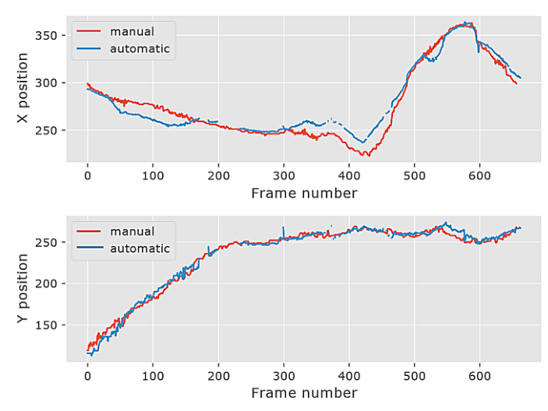
Results: Player paths
Compared to ground truth using mean distance
Background
Objective
Method
Results
Conclusions
Notes:
Player paths were compared using mean distance

Slide 16
Results: Player paths
Background
Objective
Method
Results
Conclusions
Calibration method | Video material
 | 1 | 2 | 3
3 key-frames | 9.694 | 9.816 | 27.302
2 key-frames | 9.908 | 13.399 | 28.444
Simple interpolation (reduced time span) | 18.063 | 10.562 | 9.438
Mean distances (in pixels) between paths travelled by selected player and
different calibration methods
Notes:
Also the 3 key-frames got the best results

Slide 17
Conclusions
Heatmaps and trajectories can be generated using collected data
Collecting players movement from a single camera
Small tolerance for fast camera view changes
Football pitch has to be green (and non-pitch objects in a different color)
Proposed method works in offline mode (because of Optical Flow)
Input footage has to be continuous, single shot
Future work:
Automatic camera calibration [Chen2019, Homayounfar2017]
Automatic scene detection [Wang2005]
Background
Objective
Method
Results
Conclusions
Notes:
Goal was achieved. It is possible to create system for affordable data gathering.
Proposed method works in offline mode (realtime is not possible)
There is small tolerance for fast camera view changes
Input footage needs to be continuous shot
Those problems can be eliminated.

Slide 18
References
[Baysal2015]: Baysal, S., & Duygulu, P. (2015). Sentioscope: a soccer player tracking system using model field particles. IEEE Transactions on Circuits and Systems for Video Technology, 26(7), 1350-1362.
[Santosh2019]: Santhosh, P., Kaarthick, B.: An automated player detection and tracking in basketball game. Comput. Mater. Continua 58(3), 625–639 (2019)
[Ghanem201]: Ghanem, B., Zhang, T., Ahuja, N.: Robust video registration applied to field-sports
video analysis. In: IEEE International Conference on Acoustics, Speech, and Signal Processing (ICASSP), vol. 2. Citeseer (2012)
[Ramanathan2016]: Ramanathan, V., Huang, J., Abu-El-Haija, S., Gorban, A., Murphy, K., Fei-Fei, L.: Detecting events and key actors in multi-person videos. In: Proceedings of the IEEE Conference on Computer Vision and Pattern Recognition, pp. 3043–3053 (2016)
Background
Objective
Method
Results
Conclusions

Slide 19
References
[Chen2019]: Chen, J., Little, J.J.: Sports camera calibration via synthetic data. In: Proceedings of the IEEE/CVF Conference on Computer Vision and Pattern Recognition Workshops (2019)
[Homayounfar2017]: Homayounfar, N., Fidler, S., Urtasun, R.: Sports field localization via deep structured models. In: Procedings of the IEEE Conference on Computer Vision and Pattern Recognition, pp. 5212–5220 (2017)
[Wang2005]: Wang, J., Chng, E., Xu, C.: Soccer replay detection using scene transition structure analysis. In: Proceedings (ICASSP 2005). IEEE International Conference on Acoustics, Speech, and Signal Processing, 2005, vol. 2, pp. ii/433–ii/436 (2005).
Background
Objective
Method
Results
Conclusions

